Slide 1
Introduction to PeeringDB
Arnold Nipper
arnold@peeringdb.com

Slide 2
What is PeeringDB?
Why should my facility, IXP or network be listed in PeeringDB?
Helps establish new peering more efficiently, with all information easy to find in one place
Maintain all of your contact and connection info
Find other network's peering contact and connection info
Find interconnection facility and IXP info
A PeeringDB record is required by many networks to peer
Can be used for automation to generate router configurations
Initial configuration to setup peering quickly
Update configuration if maximum prefixes change

Slide 3
Angola and its Neighbours

Slide 4
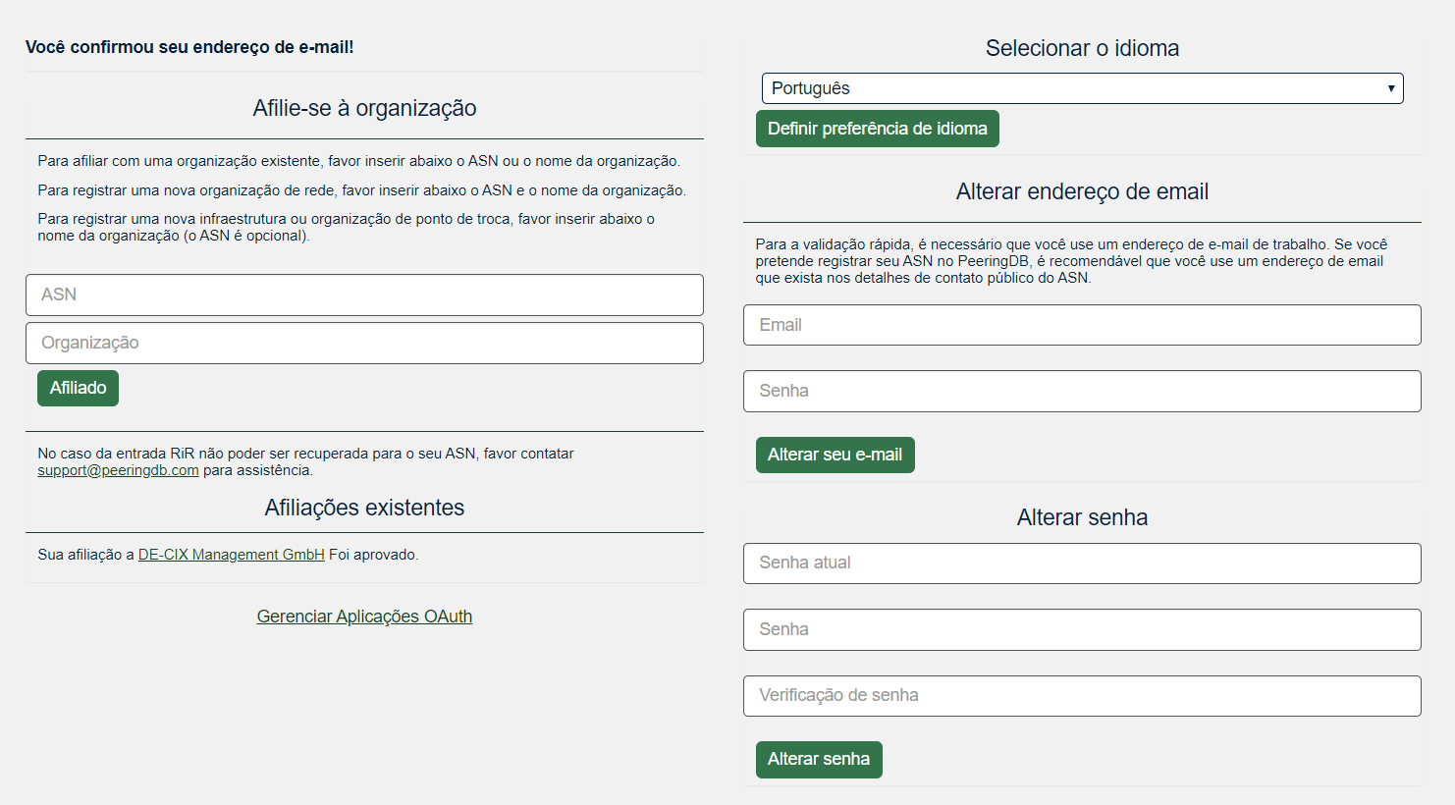
The GUI // Profile View
Select Language
Request Affiliation
Your Affiliations
Change Email and Password

Slide 5
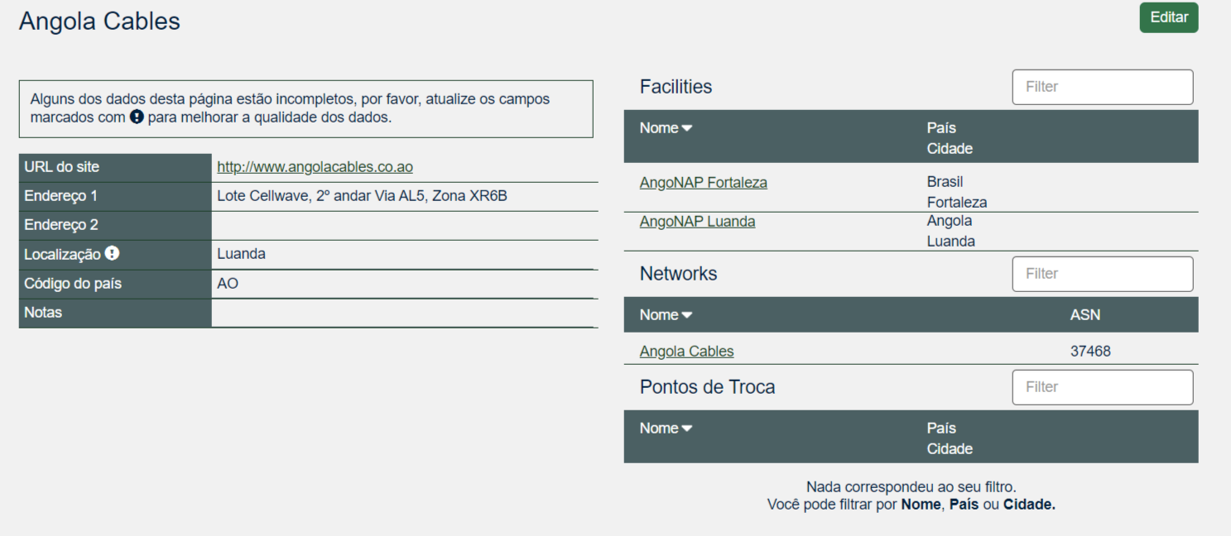
The GUI // org view
Facilities are Shown Here
Angola Cables has 2 Facilities
Networks are Shown Here
Angola Cables has 1 Network Record
Exchanges are Shown Here
Angola Cables has 0 Exchange Record

Slide 6
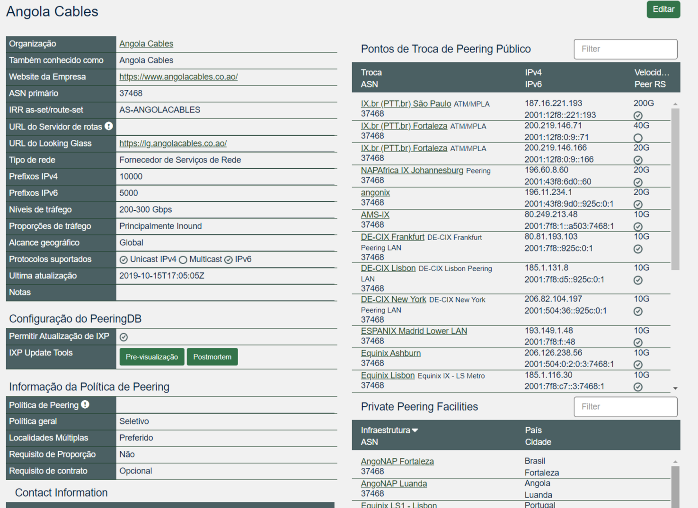
The GUI // net view
Connections to IXes are Shown Here
Angola Cables has many Connections
Connections at Facilities are Shown Here
Angola Cables has many Connections

Slide 7
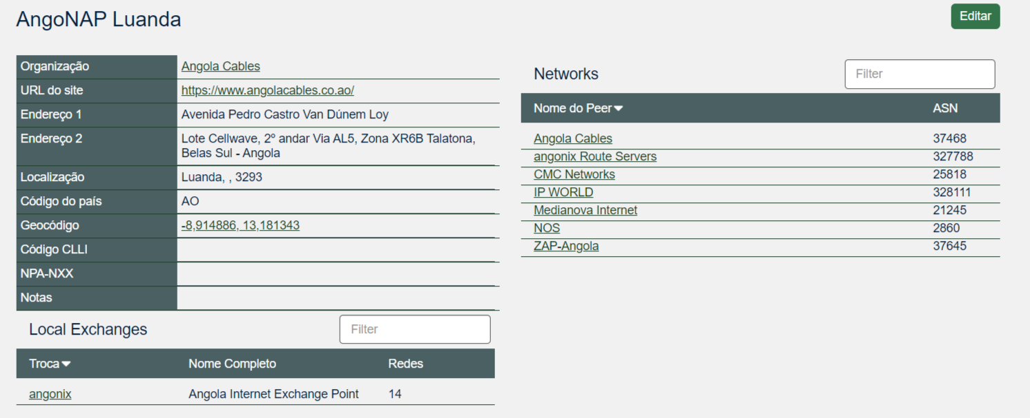
The GUI // fac view
Networks are Shown Here
AngoNAP Luanda hosts 7 networks
Local Exchanges are Shown Here
AngoNAP Luanda hosts 1 Exchange

Slide 8
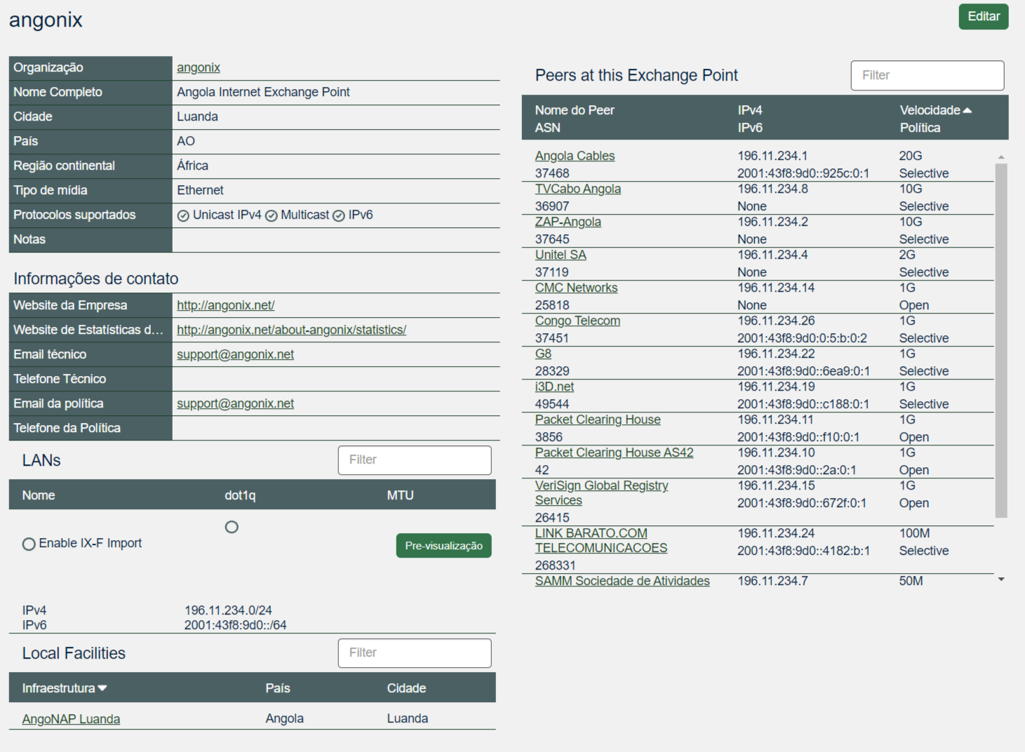
The GUI // ix View
IX Information is Shown Here
LAN Information is Shown Here
angonix has 2 IPFX Records
Facility Information is Shown Here
angonix is in 1 Facility
Peers are Shown Here

Slide 9
RESTful API Designed for Automation
All operations are supported and are designed to be automated
Read
Create
Update
Delete
Each object type has an associated tag
Basic types: org, net, ix, fac, poc, as_set
Derived types: ixfac, ixlan, ixpfx, netfac, netixlan
List of objects: https://peeringdb.com/apidocs/
API documentation: http://docs.peeringdb.com/api_specs/

Slide 10
Quick Example Output in JSON
List all networks: curl -sG https://peeringdb.com/api/net
Specific: https://peeringdb.com/api/net/7245?pretty&depth=0&fields=id,org_id,name,asn,created,updated
{
"meta": {},
"data": [
{
"id": 7245,
"org_id": 9949,
"name": „angonix Route Servers",
"asn": 327778,
"created": "2014-09-12T08:14:51Z",
"updated": "2017-04-09T17:11:48Z"
}
]
}

Slide 11
Governance and Membership
PeeringDB is a United States 501(c)(6) volunteer organization that is 100% funded by sponsorships
Healthy organization, building financial reserves and executing the long term strategic plan
Membership rules
A corporation, limited liability company, partnership or other legal business entity may be a Member of the Corporation
Membership is determined by having both an active PeeringDB.com account and an individual representative or role subscription to the PeeringDB Governance mailing list
344 addresses subscribed to the Governance mailing list (as of April 16, 2019)
Governance list is at http://lists.peeringdb.com/cgi-bin/mailman/listinfo/pdb-gov
More information available at http://gov.peeringdb.com/

Slide 12
Committees
Admin Committee | Operations Committee | Outreach Committee | Product Committee
Manage administration of user accounts and PeeringDB records Answer support tickets Cleansing and completion of PeeringDB records Leads: Stefan Funke (Chair) Contact:admincom@ lists.peeringdb.com | Manage PeeringDB infrastructure Leads: Job Snijders (Chair) and Aaron Hughes (Vice Chair) Contact: pdb-ops@ lists.peeringdb.com | Manage marketing and social media Develop and maintain presentations, workshops and webinars Coordinate presentations and attendance at events Leads: Greg Hankins (Chair) and Bijal Sanghani (Vice Chair) Contact: outreachcom@ lists.peeringdb.com | Manage roadmap and development priorities Ask for input from the community on desired features Write SoWs to solicit bids to complete requested features Leads: Stephen McManus (Chair) and Matt Griswold (Vice Chair) Product Manager: Filiz Yilmaz Contact: productcom@ lists.peeringdb.com

Slide 13
Support Ticket Statistics
300% Increase!
Admin Committee volunteers are based around the world in a variety of time zones with diverse language skills
Goal is to resolve support tickets within 24 hours
Notes:
The increase in tickets from 1.0 to 2.0 are primarily due to new registrations.

Slide 14
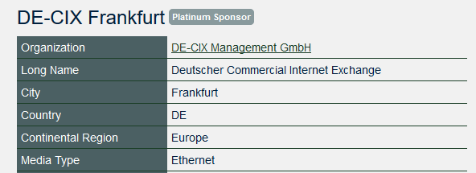
Become a PeeringDB Sponsor!
Diamond Sponsorship - $25,000 / year
Limited to 2 sponsors
Very large logo on top line of Sponsors page with URL
Diamond Sponsor badge display on all records
Social media promotion
Platinum Sponsorship - $10,000 / year
Large logo on second line of Sponsors page with URL
Platinum Sponsor badge display on all records
Social media promotion
Gold Sponsorship - $5,000 / year
Medium logo on third line of Sponsors page
Gold Sponsor badge display on all records
Social media promotion
Silver Sponsorship - $2,500 / year
Small logo on fourth line of Sponsors page
Silver Sponsor badge display on all records
Social media promotion
Contact sponsorship@peeringdb.com for sponsorship info!

Slide 15
Thank you to our sponsors!
Diamond Sponsor
Platinum Sponsors
Gold Sponsors
Silver Sponsors
Notes:
Logo height proportions: 100%, 85%, 65%, 40%

Slide 16
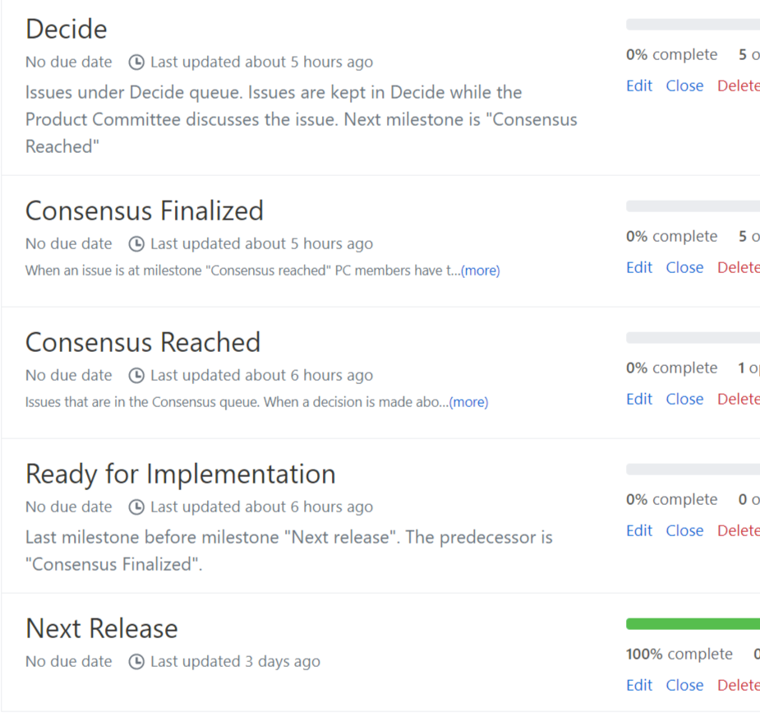
Feature Workflow
All features tracked using GitHub at https://github.com/peeringdb/peeringdb/issues with the ZenHub overlay
Anyone can open a feature requests, there are no internal or hidden requests
Open and transparent process for feature development
Workflow is at http://docs.peeringdb.com/workflow/
Product Committee feature process
Evaluate and prioritize the requests
Request a quote for development costs
Request budget from the board
Manage implementation and scheduling
Your input is needed on features!

Slide 17
Release Process
Announced at least one week in advance with all changes to give the community notice
Beta site is already running the development version for testing
Announced on PDB Announce list, Twitter, Facebook
Released on Wednesdays at 0400Z and avoids
Mondays and Fridays
International holidays
Large conferences and events (APRICOT, EPF, GPF, NANOG, RIPE, etc.)
List of current changes (release notes) for each version are on GitHub at https://github.com/peeringdb/peeringdb/milestones

Slide 18
Beta Development
Beta server
Available at https://beta.peeringdb.com/
Runs the latest beta software version
Full access over HTTP and the API
Database is local to the beta server only, changes are not reflected on the production servers
Latest changes
Available at https://beta.peeringdb.com/changes
Redirects to the list of issues on GitHub
Documents all of the changes in the current beta version
Anyone can log bugs and feature requests in GitHub at https://github.com/peeringdb/peeringdb/issues

Slide 19
Recent Development Highlights
Product Committee Decision Making process
Renewed process to act faster on issues
Product Committee Members to shepherd discussions
Logging decisions on Github for info dissemination and transparency purposes \
Translations
Process documented internally to streamline the release of translated strings
Languages will be released at 80% maturity level
Working on external website to help translators - ongoing
Vendor selection Process
Currently under discussion
Increase vendor diversity

Slide 20
Product Update
Focusing on the backlog issues, bugs and translations
Recent versions:
2.15 released on 28 August 2019
2.16 released on 18 September 2019
2.17 due on 04 December 2019
Fixes:
IANA reserved ASNs are not listed in PeeringDB
Better IP address validation
Links to maps.google.com in translations
Oauth correctly sets next URL (had priority due to IXP Manager release)
Info on Oauth at https://docs.peeringdb.com/oauth/
Newlines in JavaScript Markdown renderer behave same as in the Python renderer

Slide 21
Next Release and Discussions
Focus still on the backlog issues, bug fixes and translations
Discussions on
IX-F importer
Data deletion and how to retain deleted data for R&D purposes
Data ownership
More and more discussion on who owns the data when more than one party is involved
ixfac, netfac, netixlan
Established a Task Force to work on a policy document
Would you like to take part? Let us know!

Slide 22
What’s next?
PeeringDB
2.0
2016
2019 - 2020
2017
Process improvements
Vendor selection process
TF for data ownership
Backlog clean up and bug fixes
Add more Languages
Turkish, Arabic, Romanian are recent additions
Improve translation tools
to help translators
Collect user stories
Identify new features/changes
Bug Fixes
Django
IX-F JSON
2018
Process/New Features
Outreach
Surveys
Translations
API

Slide 23
Information and Resources
Announce list: http://lists.peeringdb.com/cgi-bin/mailman/listinfo/pdb-announce
Governance list: http://lists.peeringdb.com/cgi-bin/mailman/listinfo/pdb-gov
Technical list: http://lists.peeringdb.com/cgi-bin/mailman/listinfo/pdb-tech
User Discuss list: http://lists.peeringdb.com/cgi-bin/mailman/listinfo/user-discuss
Docs, presentations, guides, tools: http://docs.peeringdb.com/
Board and Officers: stewards@lists.peeringdb.com
Admins: support@peeringdb.com
Presentation requests: outreachcom@lists.peeringdb.com
Uptime status: http://status.peeringdb.com/
Bugs and feature requests: https://github.com/peeringdb/peeringdb/
Social media:
https://www.facebook.com/peeringdb/
https://www.linkedin.com/company/peeringdb
@PeeringDB

Slide 24
Questions?

